Slide 1
Serving electors with disabilities –Elections Canada’s experience
Melanie Wise Senior Communications Advisor, Elections Canada September 23, 2014

Slide 2
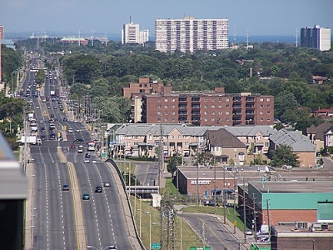
Election delivery
338 ridings
36-day calendar
~ 20,000 polling sites
~ 250,000 election workers
1

Slide 3
People with disabilities in Canada
~ 3.8 million; rate increases with age
most common: pain, lack of flexibility, lack of mobility
2

Slide 4
Barriers
Information and communications
Architectural and physical
Attitudinal
Organizational
Technological
Socioeconomic
3

Slide 5
Legal framework
Canada Elections Act
Canadian Charter of Rights and Freedoms
Canadian Human Rights Act
UN Convention on the Rights of Persons with Disabilities
4

Slide 6
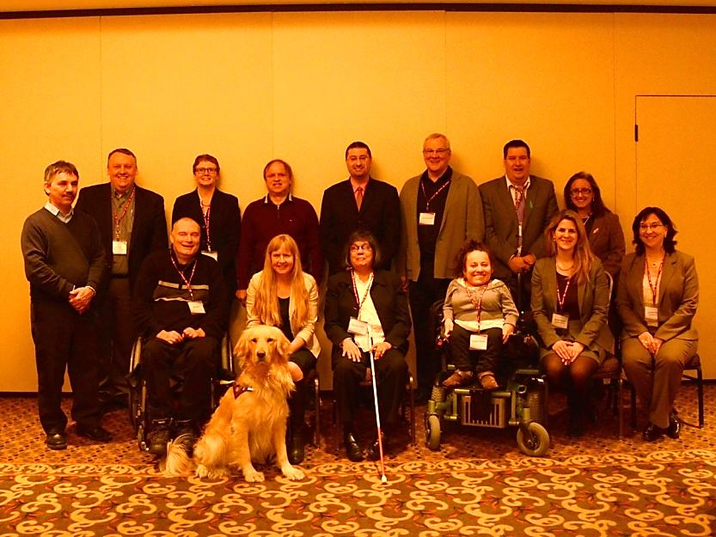
Consultations
Consulted 19 disability organizations
Created Advisory Group for Disability Issues
Their recommendations:
Use universal approach in communications: plain language, easy navigation
Improve voting experience at the polls: magnifiers, better lighting and signage
Facilitate more independence at the polls
Better train election workers
5

Slide 7
Voting services
Electors can vote:
at advance polls
by mail
in person at any Elections Canada office
at home, in the presence of an election officer and witness
at acute-care hospitals, seniors’ homes and long-term care facilities
6

Slide 8
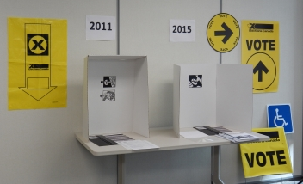
Voting services- at the polls
Sites evaluated against 37 criteria (15 mandatory)
If no automatic door opener, staff posted to open door
Voting template that fits on top of a ballot
Lists of candidates in Braille, large print
Sign-language interpretation
Help marking a ballot
New voting screen
Improved signage
7

Slide 9
Information products
Revamped website, communications products
Several carry info on accessibility of polling place
Many formats:
Braille
Large print
videos with open captioning in sign languages
TTY line
Websites - meet WCAG standards to level AA
Broadcast info on accessible media channels, distribute via disability groups
8

Slide 10
Customer service
New community relations officer for accessibility
Improved cross-disability training for election workers
More promotion of services and tools for people with disabilities
Accessibility feedback process
9

